Slide 1
Day 5 Asset Accounting Configurations
Notes:
This In-house course was developed to meet the needs of SAP R/3 Consultants working at Capgemini. This course is designed to present a high level view of XXXX and to provide the Consultants with basic information about how to use this Functionality.
More in-depth courses have been developed to train Consultants in specific areas discussed during this course.
Your comments at the conclusion of this training session are appreciated and will help us better tailor future courses to meet your training needs.

Slide 2
Asset configuration
Copy reference chart of depreciation/depreciation areas
Assign Chart of depreciation to Company codes
Specify Account determination
Create screen layout rules
Define Number range interval
Define Asset Classes
Determine depreciation areas in the Asset classes
Assign of G/L Accounts
Define document types
Specify document type for posting of depreciation
Specify Intervals and posting rules
Specify rounding off Net book value and/or depreciation
Define screen layout for Asset Depreciation areas
Maintain Depreciation keys
Assign Settlement profile to Company code

Slide 3
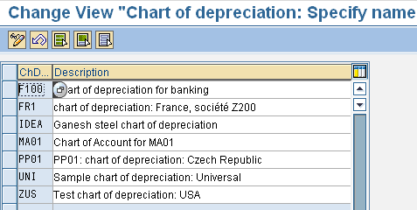
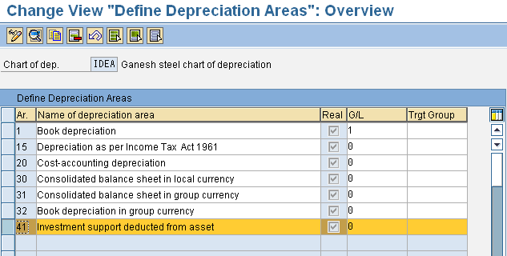
Copy reference chart of depreciation/depreciation areas
Menu Path: IMG→ Financial Accounting (New) → Asset Accounting → organisational structures → Copy reference chart of depreciation / depreciation areas.
Could delete the dep. area
Notes:
The chart of depreciation is a catalog of country-specific depreciation areas. Chart of depreciation is a list of depreciation areas which are all useful for business, legal requirement and statutory requirements.
SAP supplies charts of depreciation as references that are based on the requirements of each country. You can create a new chart of depreciation by copying one of the reference charts of depreciation
In your chart of depreciation you can delete the depreciation areas those you not required. This deletion must be done before creation of any asset.

Slide 4
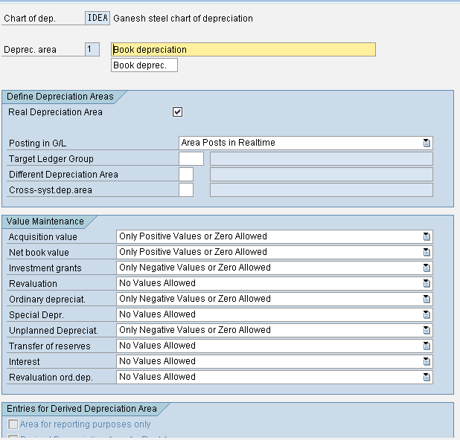
Copy reference chart of depreciation/depreciation areas Contd..
Depreciation postings would be done in G/L Accounts
Notes:
For various business and legal purposes, fixed assets are valued differently (e.g., book depreciation, tax depreciation, and cost-accounting depreciation). FI-AA manages these different types of valuation of fixed assets in the depreciation areas.

Slide 5
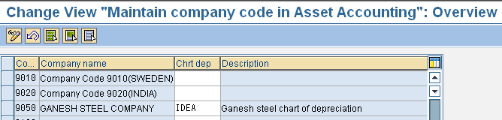
Assign Chart of depreciation to Company codes
Menu Path: IMG→ Financial Accounting (New) → Asset Accounting → organisational structures → Assign Chart of depreciation to company code.
Assigned
Notes:
This configuration is used to assign company code to chart of Depreciation.
One chart of depreciation can be assigned to many Company codes.

Slide 6
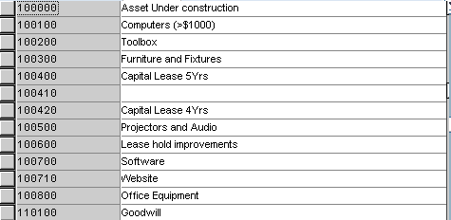
Specify Account determination
Menu Path: IMG→ Financial Accounting (New) → Asset Accounting → Organisational structure → Asset Classes → Specify Account Determination
Low value assets
The key of an Account determination is stored in the Asset class. So that it plays a role to link Asset Master and the General ledger to be posted for an accounting transaction.
Notes:
Account determination, Screen lay out rules and number ranges are key inputs for creation of any ASSET CLASS.

Slide 7
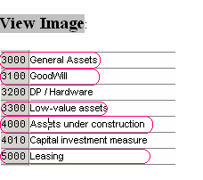
Create screen layout rules
Menu Path: IMG→ Financial Accounting (New) → Asset Accounting → Organisational structure →Asset Classes → Create screen Layout rules
The Screen layout specifies the fields’ status in the Asset Master record. i.e they are required, optional or suppressed. These screen layout rules are assigned in asset classes so the Assets are created do follow the same rules for the Asset class.
Notes:
Account determination, Screen lay out rules and number ranges are key inputs for creation of any ASSET CLASS.

Slide 8
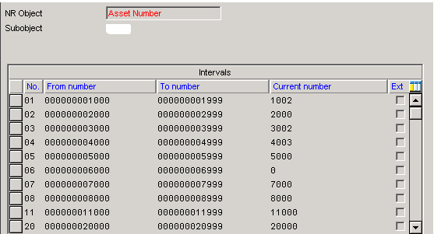
Define Number range interval
Menu Path: IMG→ Financial Accounting (New) →Asset Accounting → Asset Classes → Define Number range Interval.
9050
The number ranges for the assigned company code relevant for Assets created under that company code.
Notes:
Account determination, Screen lay out rules and number ranges are key inputs for creation of any ASSET CLASS.

Slide 9
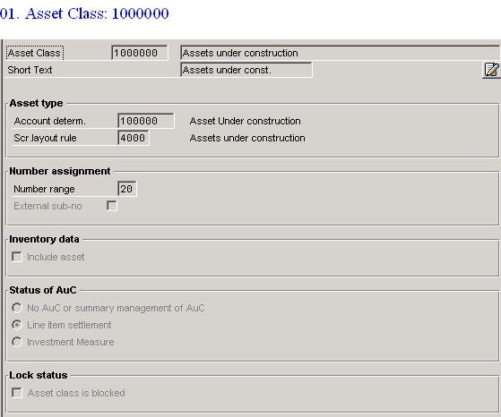
Define Asset classes
Menu Path: IMG> Financial Accounting (New) >Asset Accounting> Asset Classes > Define Asset Classes.
Notes:
Account determination, Screen lay out rules and number ranges are already defined to consider here. And by selecting “ Line item settlement” in status of AUC to make the settlement at transaction level.
We need to opt “Investment Measures” if there is a plan to implement and link with Investment Management module for AUC assets class.

Slide 10
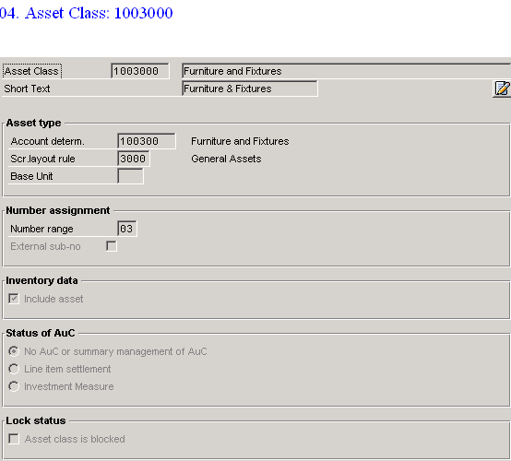
Notes:
Besides Account determination, Screen lay out rules and number ranges, if there is a plan to include all assets in this Asset class in Inventory data the option needs to be checked.

Slide 11
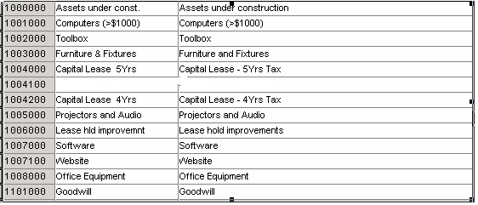
The various Asset classes:
Low value assets
Low value assets
Asset class is nothing but a Asset portfolio, which contains control parameters, default values for General Master data and default values for depreciation terms in chart of depreciation

Slide 12
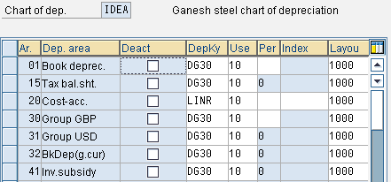
Determine depreciation areas in the Asset class
Menu Path: IMG> Financial Accounting (New) >Asset Accounting> Valuation > Determine depreciation areas in the Asset class.
Once these depreciation areas assigned to Asset classes then system automatically takes these depreciation areas & keys in the Assets master when we create the Asset by default.

Slide 13
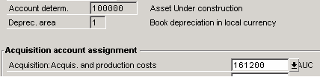
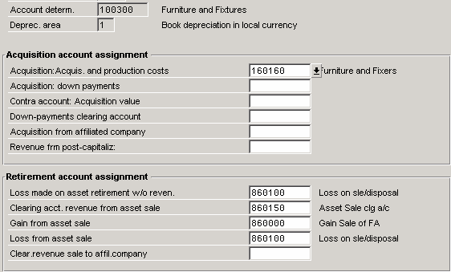
Assign G/L Accounts
Menu Path: IMG → Financial Accounting (New) → Asset Accounting> Integration with General Ledger → Assign G/L Accounts
Assignment of G/L Accounts to Account determination

Slide 14
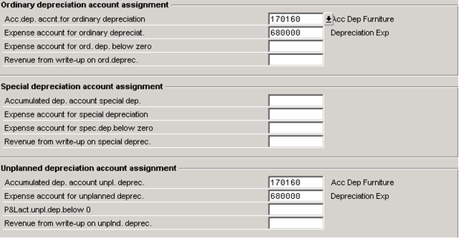
Notes:
The assignment of G/L Accounts are required for Acquis.& production cost., Loss Made on Asset sale without revenue, Clearing acct. Revenue from Asset sale, Gain from Asset sale, Loss from Asset Sale, Depreciation, Accumulated depreciation, Expense Account for interest & Clearing Interest posting.

Slide 15

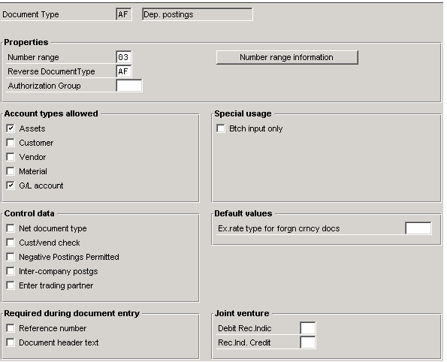
Specify document type for posting of depreciation
Menu Path: IMG→ Financial Accounting (New) → Asset Accounting → Integration with General ledger → Post Depreciation to the general ledger → Specify document type for posting of depreciation
Notes:
Assignment of Company code to document type for depreciation posting.
A document type is required to post the depreciation as well as number range for the documents

Slide 16
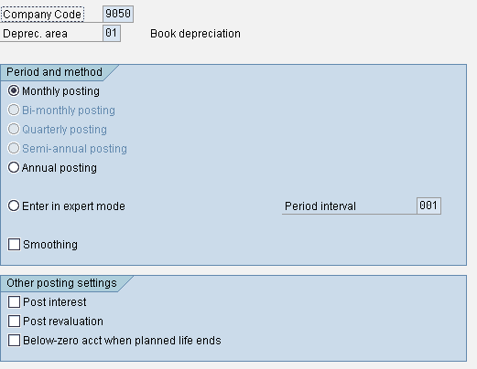
Specify intervals and posting rules
Menu Path: IMG → Financial Accounting (New) → Asset Accounting → Integration with General ledger → Specify Intervals and posting rules.
Depreciation and Interest postings will be done based on the period settings.

Slide 17
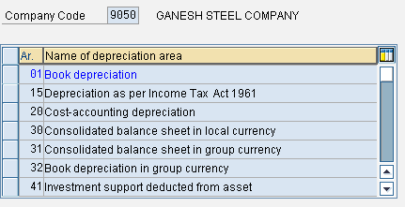
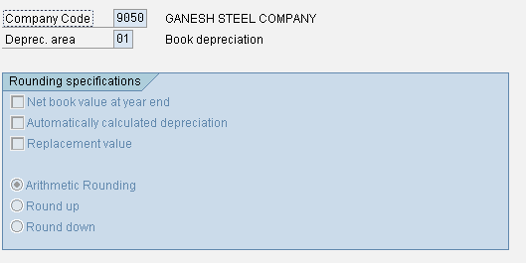
Specify rounding off Net book value and/or depreciation
Menu Path: IMG → Financial Accounting (New) → Asset Accounting> Valuation → Amount specification Co.code/ Depreciation Area → Specify rounding of NBV and/or depreciation
Notes:
To specify rounding of NBV amount and/or depreciation amount and specific to Company code.

Slide 18
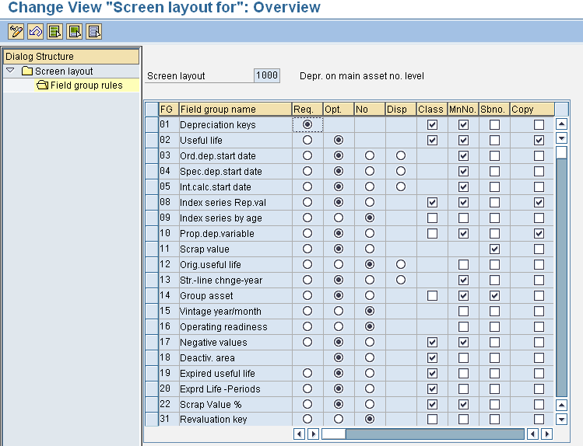
Define screen layout for Asset depreciation areas
Menu Path: IMG> Financial Accounting (New) >Asset Accounting> Master data > Screen layout > Define Screen layout for Depreciation Areas
Notes:
This configuration is used to control depreciation terms in Asset Master data.

Slide 19
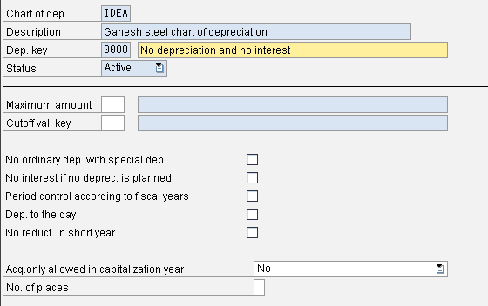
Maintain depreciation key
Menu Path: IMG →Financial Accounting (New) →Asset Accounting> Depreciation → Valuation Methods →Depreciation key →Maintain Depreciation key
This is SAP standard key for AUC assets class
Notes:
This configuration is used to assign calculation methods to depreciation keys.
The computation of depreciation in different depreciation areas based on depreciation keys assigned to them.
The roles of calculation methods in the depreciation key.
Base Method:
Type of depreciation : Ordinary depreciation
Dep. Method : Stated percentage
Declining balance method:
For each declining-balance method, specify:
A multiplication factor for determining the depreciation percentage rate
An upper limit for the depreciation percentage rate
A lower limit for the depreciation percentage rate
Maximum amount method:
The calculation method contains a maximum depreciation amount that is not allowed to be exceeded before a certain calendar date. If the depreciation calculated by the system exceeds this maximum amount, then the system reduces depreciation to this maximum amount.
Multi level method:
Each level represents a validity period for a given percentage rate.
Period control method:
Assign period control keys to the period control methods for:
Acquisition transactions, Subsequent acquisitions, Retirements and transfers
The other settings in the depreciation key:
Depreciation class: Straight line or Declining balance method
Change over method:
Specifies when the changeover to a different phase of the depreciation key takes place.
You can maintain phases in depreciation duration by mentioning changeover methods as we required.
Cut off value key:
Scrap value

Slide 20
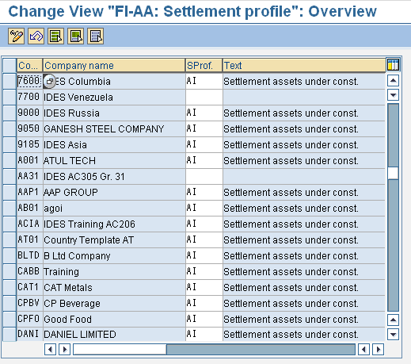
Assign settlement profile to Company code
Menu Path: IMG> Financial Accounting (New) >Asset Accounting> Capitalisation of assets under construction>Define/Assign settlement profiles
Notes:
This is a basic configuration used to assign settlement profile for each Company code
Based on assigned settlement profile, we can define settlement rules for the Asset Under Construction.
We need to create the distribution rules (percentage rate or equivalence numbers) for the line items to settle for the Asset Under construction.
The system then settles the line items, to which the distribution rule with receivers have been assigned

